Slide 1


Did you hear? 2,285 voices!

Slide 2

2022
Notes:
Every five years, Indiana County – through its Department of Human Services – and collaborative partners conducts a survey to assess the health and human services needs of our residents. The latest survey, “Indiana County Speaks Up 2022”, was distributed in in the from March 2022 to December 2022, for residents to complete; they had the option to fill in the paper copy or submit their answers electronically.
This presentation will look at some of the results from the 2022 survey and compare them to the previous surveys. First let talk look at the history of Indiana County Speaks Up

Slide 3

Notes:
In January of 2002 the first meeting of the Indiana County Speaks UP! comprehensive needs assessment project was convened. The Needs Assessment Committee members were representatives of the Children’s Advisory Commission, Indiana County Department of Planning, Indiana County Children and Youth Services, Indiana County Head Start, Indiana University of Pennsylvania, PA Department of Health, Indiana County Guidance Center, Penn State Cooperative Extension, and the Indiana County Department of Human Services. Extensive work was put into the development of the questionnaire and related materials that were included in the “survey packet”. The final version of the survey that was sent to about 4000 randomly selected Indiana County residents. Over 1300 surveys were completed and returned by Indiana County residents. The data was analyzed and reports on topics relating to children and families were generated for the CAC and other interested groups.
The top priorities are:
· Reduce drug & alcohol use among youth
· Combat juvenile delinquency
· Help youth develop life skills
· Increase Recreational opportunities

Slide 4

Notes:
Will substantially less funding, the survey was conducted again in 2007. Again, it was mailed randomly to about 2000 residents, this time with a 25% return rate: and again the top priorities for children and youth were:
Reduce drug & alcohol use among youth
· Combat juvenile delinquency
· Help youth develop life skills
· Increase Recreational opportunities
And reduce teen sexual activity

Slide 5


Notes:
For the 2012 survey Over 1,100 people gave their opinions on needs and information about their households. The majority of those responded to the survey online.
The groups and agencies involved in the development of the survey and in analyzing the results were:
Indiana County Department of Human Services
Children’s Advisory Commission of Indiana County
Evergreen Boys & Girls Club
Indiana Regional Medical Center
IUP – Eberly College of Business and Information Technology
PA Mountain Service Corps
United Way of Indiana County
For the most part results were comparable to the results in the past surveys. Also the, the demographic data was consistent in most cases with the data collected in the 2012 US Census.

Slide 6

Notes:
The 2017 survey was conducted from November 2017 through the end of January 2018. The majority of the 1106 responses were done online. The Indiana County Department of Human Services and the Children’s Advisory Commission conducted the survey and analysis. We used the questions from the 2007 & 2012 surveys to continue to be able to compare changes (or no changes) in perspective throughout the years.
There were some additional questions added, including questions about grandparents raising grandchildren, disaster preparedness, and most notable, an open ended question about heroin/opiod use.

Slide 7
2022
Notes:
For 2022 we streamlined the survey to make it a bit shorter, and changed the open-ended question from an opioid focused question to to the more general “What else do you feel is important for the people who plan services in Indiana County to consider?” The response was more than double from 2017, and the highest to date. What had changed in the last 20 years??? So, let’s hear what we had to say.

Slide 8


Anna
Notes:
In Indiana, ANNA is the composite example of a survey respondent.

Slide 9

Meet Anna
Notes:
Anna is a 45/55 something, married, white woman living in Indiana County. Almost ½ of the respondents were in this age range.. 96% of the respondent identified as white. Anna has schooling beyond college. 33% of the respondents answering the survey have schooling/training beyond high school. 21% have a 4 year degree, and 20% have one or more graduate degrees.

Slide 10
Gender
 | 2022 | 2017 | 2012 | 2007 | 2002
Females | 75% | 73% | 72% | 63% | 62%
Males | 24% | 26% | 28% | 37% | 38%
Other | 1.5% | 1%
Notes:
States on age, race, education, and gender have remained close through all of the years the survey has been conducted, Census information shows that about 50% of the population is female. .

Slide 11

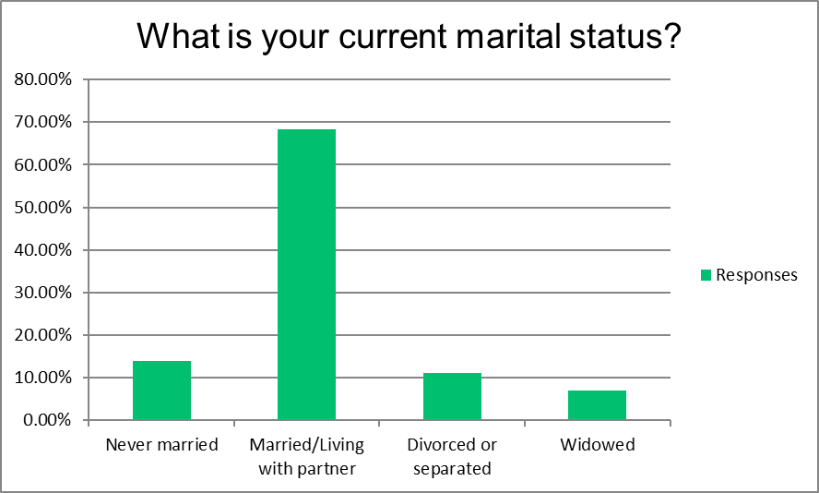
Notes:
Anna is married to Joe

Slide 12

Children newborn to 4 years old | 61.53%
Children 5 to 11 years old | 63.45%
Children 12 to 18 years old | 63.11%
Young Adults 19 to 21 years old | 57.97%
Notes:
They have are likely to have children, or grandchildren living in their home.

Slide 13

Years Living in Indiana County
 | 2022 | 2017 | 2012 | 2007 | 2002
Less Than 1 Year | 2% | 1% | 3% | 2% | 1%
Less Than 10 Years | 12% | 11% | 16% | 14% | 9%
More Than 10 Years | 7% | 6% | 9% | 7% | 6%
More Than 15 Years | 79% | 82% | 73% | 77% | 85%
Notes:
She has lived in Indiana County for over 15 years

Slide 14

Employment
 | 2022 | 2017 | 2012 | 2007 | 2002
Self-Employed | 14% | 14% | 13% | 13% | 13%
Employed Full-Time | 56% | 67% | 60% | 39% | 40%
Employed Part-Time | 16% | 19% | 23% | 12% | 12%
Take Care of House/Children | 60% | 56% | 60% | 23% | 20%
Student | 5% | 9% | 13% | 2% | 3%
Retired | 31% | 18% | 19% | 32% | 32%
Unemployed | 8% | 9% | 15% | 6% | 6%
Other | 6% | 7% | 12% | 6% | 5%
Work Location
 | 2022 | 2017 | 2012 | 2007 | 2002
Inside the County | 54% | 83% | 87% | 84% | 72%
Outside the County | 14% | 17% | 13% | 16% | 28%
Notes:
There is a 56% chance that Anna is employed in a full-time job (where she wears a suit and sensible shoes) in Indiana County.

Slide 15

2022 Answer Choices | Responses
Inside of Indiana County | 54% | 991
Outside of Indiana County | 14% | 237
Work remotely all of the time | 3% | 59
Work remotely part of the time | 3% | 62
Not Applicable | 31% | 570

Slide 16

Household Income, all sources, before taxes.
 | 2022 | 2017 | 2012 | 2007 | 2002
Less Than $7,000 | 1% | 2% | 6% | 3% | 4%
$7,000 - $9,999 | 1% | 1% | 4% | 3% | 3%
$10,000 - $14,999 | 3% | 3% | 4% | 5% | 9%
$15,000 - $19,999 | 2% | 2% | 3% | 6% | 9%
$20,000 - $24,999 | 4% | 5% | 4% | 6% | 11%
$25,000 - $29,999 | 3% | 5% | 4% | 6% | 8%
$30,000 - $34,999 | 5% | 4% | 4% | 10% | 9%
$35,000 - $39,999 | 5% | 5% | 4% | 5% | 9%
$40,000 - $74,999 | 24% | 26% | 19% | 35% | 28%
$75,000 - $99,999 | 14% | 15% | 11% | 10% | 7%
$100,000 or More | 19% | 15% | 12% | 11% | 4%
Prefer not to answer | 17% | 17% | 24% | NA | NA
Notes:
by comparing the responses to the previous years, when “prefer not to answer” was not an option, it is likely that her household falls in the 40,000-74,000 range. The Median 2020 household income of an Indiana County resident is $49,270 a year. The US average is $71,886 a year.

Slide 17

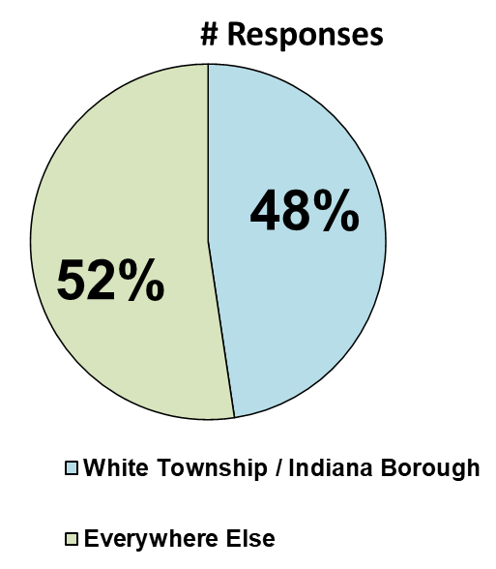
Notes:
Anna could live anywhere in Indiana County

Slide 18

So, what does Anna think about living in Indiana County?
Notes:
So, What dose Anna think about living in Indiana County?

Slide 19
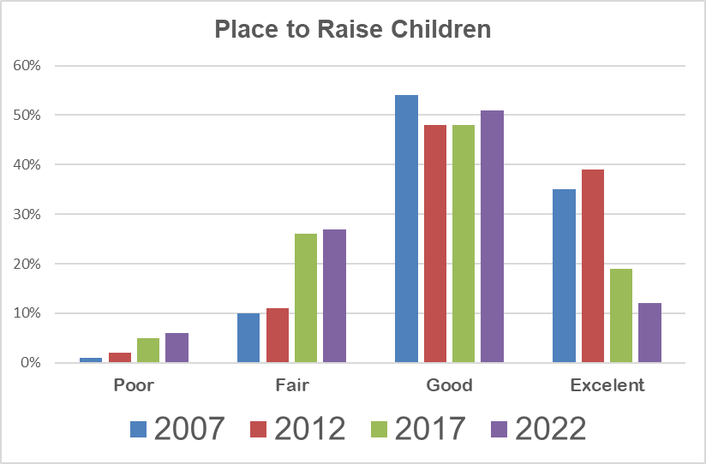


Slide 20
How would you rate Indiana County in regard to each of the following characteristics?

Slide 21
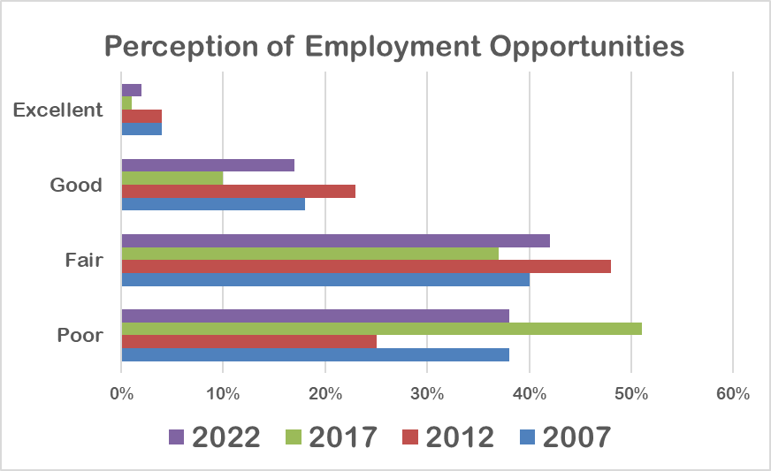

 | Poor | Fair | Good | Excellent
2007 | 38% | 40% | 18% | 4%
2012 | 25% | 48% | 23% | 4%
2017 | 51% | 37% | 10% | 1%
2022 | 38% | 42% | 17% | 2%
Notes:
However, when it comes to employment opportunities, the perception changes. Even though Employment opportunities are viewed more slightly favorably in 2012 than in 2007, in 2017 that has plummeted to 51% feeling that employment opportunities are poor.

Slide 22

Obtaining
Services

Slide 23
In the last 5 years, did you or someone who lives in your household have trouble obtaining:

Slide 24
In the last 5 years, did you or someone who lives in your household have trouble obtaining:

Slide 25

Child Care

Slide 28
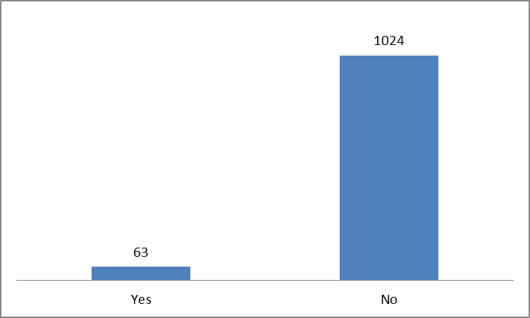
Are you raising the child(ren) of a relative or someone else with a close connection to you?
2017

Slide 29
If yes to, what is your relationship with the child(ren)?
Answer Choices | Responses
Grandparent | 44.67% | 67
Aunt or Uncle | 14.00% | 21
Step-parent | 15.33% | 23
Family Friend | 7.33% | 11

Slide 30

Priorities

Slide 31
What priority do you think should be given during the next five years to programs in Indiana County that…

Slide 32
What priority do you think should be given during the next five years to programs in Indiana County that…

Slide 33
2022 Highest Priority given to programs that:
Help youth develop life skills
Provide mental health services
Reduce drug and alcohol use among youth
Provide recreational activities for youth
Affordable housing for the elderly
Provide education on suicide prevention in the schools
Provide emergency food
Address domestic violence and abuse
Provide recreational activities for families
Reduce drug and alcohol use among adults

Slide 34
2017 Highest Priority given to programs that:
Reduce drug and alcohol use among youth
Reduce drug and alcohol use among adults
Provide education on suicide prevention in the schools and the community
Provide affordable housing for the elderly
Help youth develop life skills
Provide mental health services
Address domestic violence and abuse
Combat juvenile delinquency
Provide parenting education
Provide recreational activities for youth

Slide 35
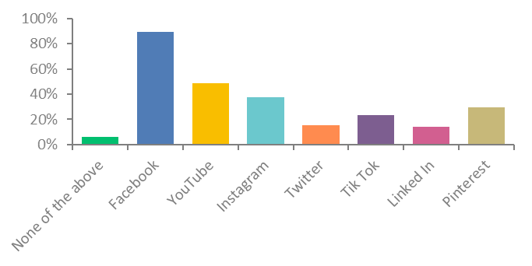
What Social Media Sites do you use?

Slide 36

Solutions

Slide 37
The results of the needs assessment will be utilized in various ways, including planning for future services, allocating funds to help meet the needs, using data to support needs assessments in federal, state and local grant applications, and assisting agencies and groups in their strategic planning.

Slide 38



Thank you!
Now Lisa will talk about the open ended questions.
Summary Report
Resuls ro th 012 Survey
A Comparison of Results from the 2002, 2007, and 2012 Indiana County Surveys
Notes:
Report soon to be available.

Slide 39
Contact:
Lisa Spencer, Director
Indiana County Department of Human Services
724-463-8200 x 4
icdhsdir@comcast.net
Maureen Pounds, Assistant Director
Indiana County Department of Human Services
724-463-8200 x 3
info32@comcast.net
Kathy Abbey-Baker, Coordinator
Children’s Advisory Commission of Indiana County
724-463-8200 x 8
indianacountycac@yahoo.com
Summary Report
Resuls ro th 012 Survey
A Comparison of Results from the 2002, 2007, and 2012 Indiana County Surveys
Notes:
Report soon to be available.

